Slide 1
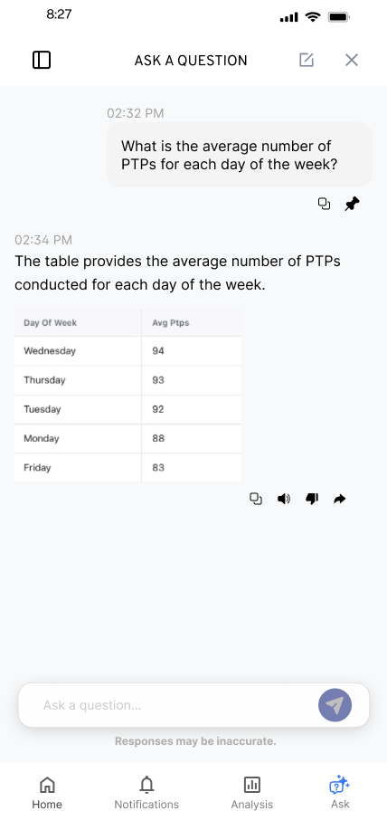
KYLE HOBSON / UX DESIGN
Complex products.
Clear next steps.
I make AI and information-rich products
easier to understand.
Selected design work, 2023–2026
01
Notes:
Kyle Hobson, UX Designer. Source: selected original SmartTagIt Flint design export. Interface content and values are illustrative design content. The deck discusses design deliverables, handoff and proposed iterations, with work stage stated at each case opening.

Slide 2
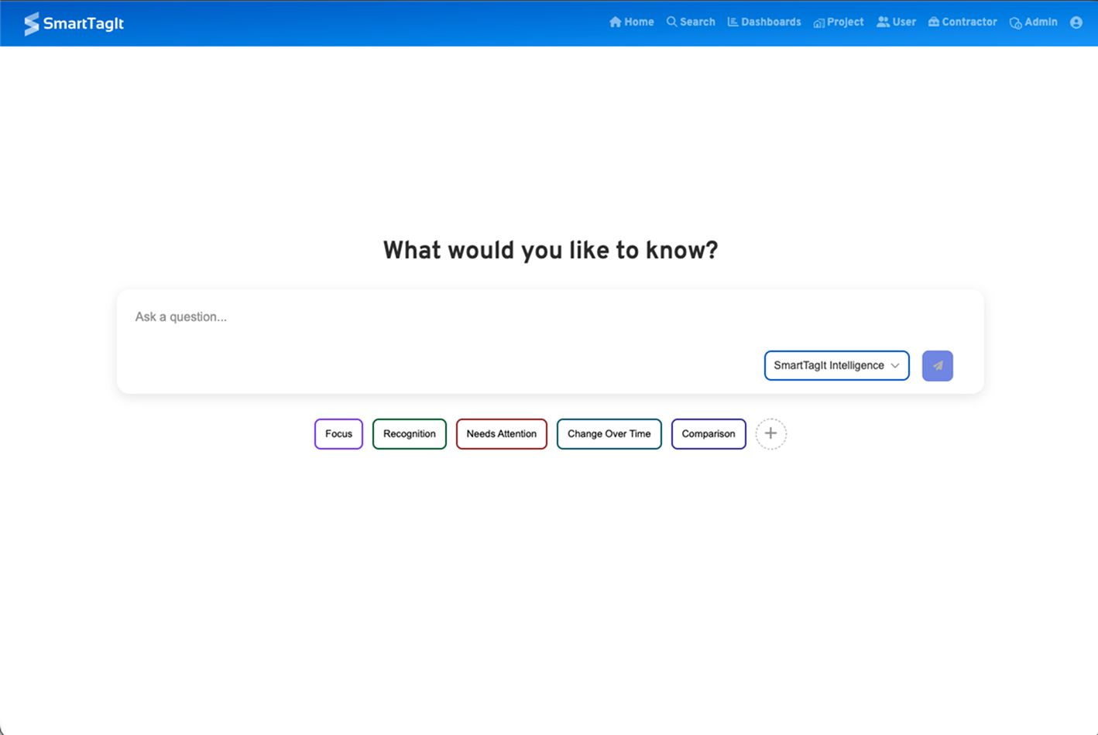
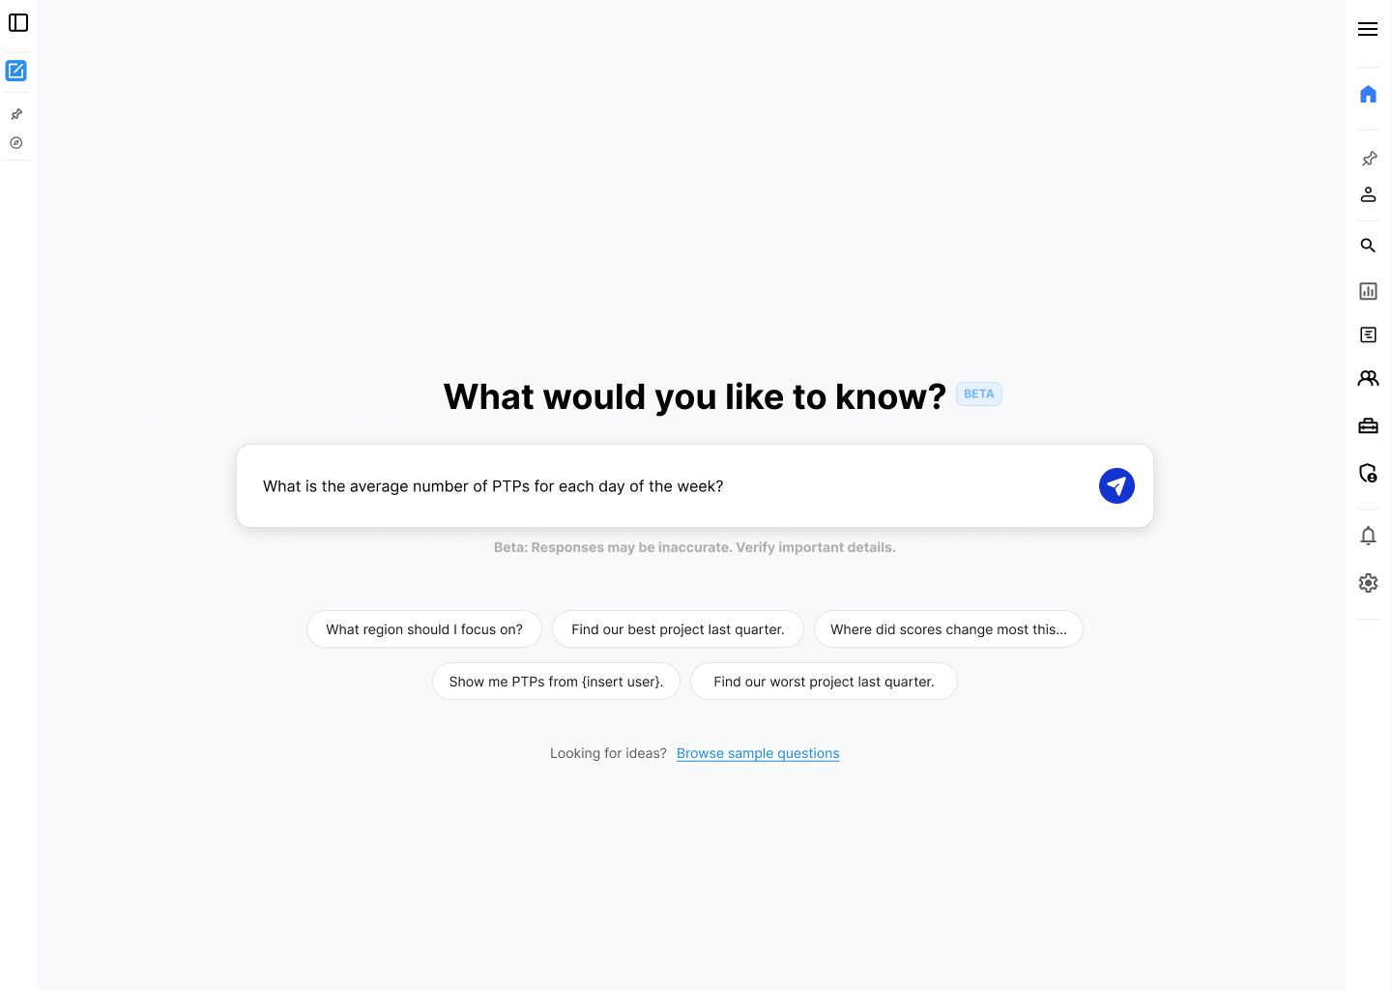
FLINT / SMARTTAGIT, FACTORLAB
A useful first question
BEFORE
MY DESIGN EXPLORATION
An empty field and broad categories.
Specific suggestions, ready to edit.
Original interface and revised design · UX Designer & Researcher, 2025–2026 · user impact unmeasured
02
Notes:
Case: Flint, SmartTagIt at FactorLab. Kyle: UX Designer & Researcher (Contract), 2025–2026. Source: original embedded screenshots from factorlab-slides-v1-2, page 4, visually compared with the current Google Slides source. The older interface uses an empty question field and category controls. My revised design shows concrete suggested questions and an example filled into the input for review or editing. The broader question library remains available. This comparison shows a design decision, not a measured gain or proof of the released navigation layout. The companion mobile entry remains in the website case study.

Slide 3
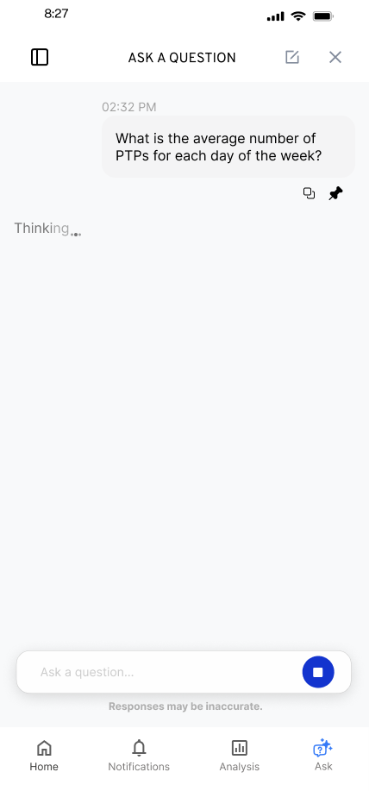
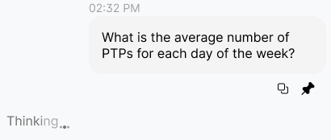
FLINT / RESPONSE IN PROGRESS
Waiting is part of
the conversation
I kept the question visible and gave the response a distinct waiting state.
Original state detail
Animation was an implementation question to resolve with engineering.
03
Notes:
Source: original Flint response-in-progress mobile export and design walkthrough. The inset enlarges an unchanged region of the same source image. Kyle explored the waiting treatment alongside the conversation and discussed animation constraints with engineering.

Slide 4
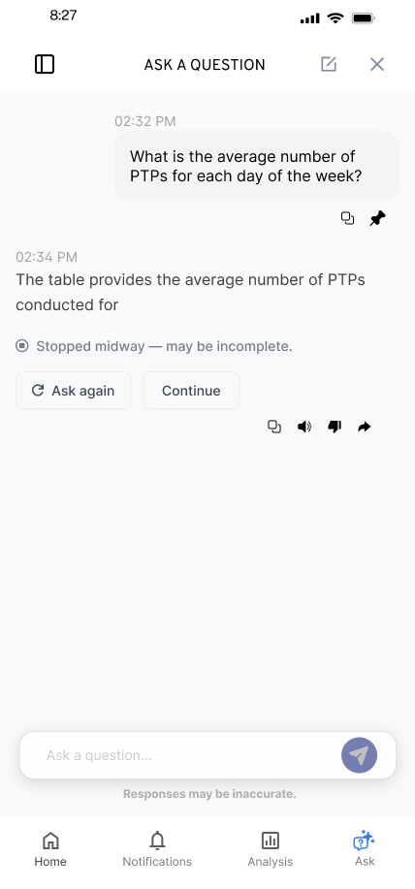
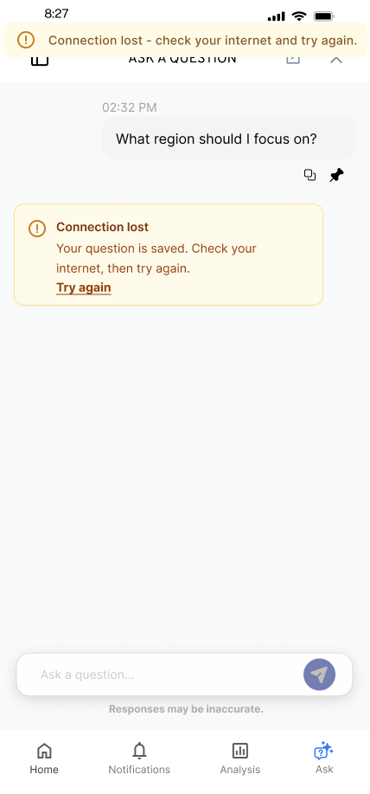
FLINT / INTERRUPTED AND OFFLINE STATES
Incomplete answer
Connection lost
Recovery follows
the failure
An incomplete answer and a lost connection need different next actions.
An August 2026 engineering reply confirmed implementation of the approved error states. The exact pictured variants remain unverified.
04
Notes:
Source: selected original Flint interrupted-response and offline design variants, including the March 27, 2026 error-state handoff. Distinct recovery actions follow the state: Ask again or Continue for a partial response, and retry after connection loss with the question preserved. Deliverable: connected flows, interaction states and engineering annotations. An August 3, 2026 engineering reply reports Ask a Question error states implemented to approved Figma; AI Assist still used older patterns. This is an implementation report, not independent behavior testing or a measured recovery improvement.

Slide 5
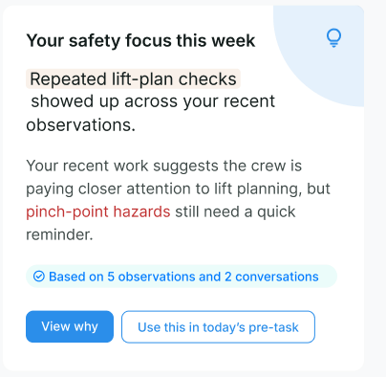
ABOUT ME / SMARTTAGIT, FACTORLAB
Feedback
with context
UX Designer & Researcher (Contract), 2026
I connected a personal summary to its supporting observations and a useful next action.
Design iterations with sample content. Engineering reported web/server live September 2 and mobile live September 3, 2026.
05
Notes:
Case: About Me, SmartTagIt at FactorLab. Kyle: UX Designer & Researcher (Contract), 2026. Source: original About Me Figma direction and April–May 2026 walkthroughs. The displayed crop retains original sample content. Engineering reported web/server changes live September 2 and both mobile apps live September 3, 2026. These images document design iterations; exact correspondence to released screens has not been verified.

Slide 6
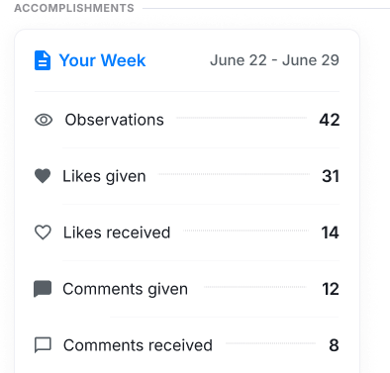
ABOUT ME / ACCOMPLISHMENTS DECISION
When the table held
more information
My grid omitted details already present in engineering’s table.
I recommended keeping the table and revised the labels to make given and received activity clearer.
Original design detail, August 2026 · values are sample content · followed-people link deferred
Table direction with clearer activity labels
06
Notes:
About Me Accomplishments decision, August 2026. Kyle compared his grid with an engineering table, identified information missing from his own version, recommended retaining the table, and refined the labels. The displayed crop of an original design omits the followed-people link because that idea was deferred. Counts and dates are sample design content, not user outcomes. Exact correspondence to a released screen remains unverified.

Slide 7
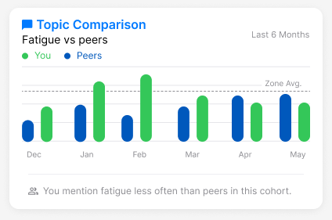
ABOUT ME / NEUTRAL COMPARISON
A comparison needs
an interpretation
Mentioning fatigue less often is a comparison. Whether that is good depends on the context.
I raised the cohort, percentile and wording questions before they became interface rules.
Original widget, illustrative values
07
Notes:
Source: original About Me Topic Comparison widget and stakeholder design discussions. Values are illustrative design content, not research outcomes. Kyle advocated neutral feedback and made cohort definition and interpretation questions explicit. The case output was a family of insight layouts and concrete product questions for alignment.

Slide 8
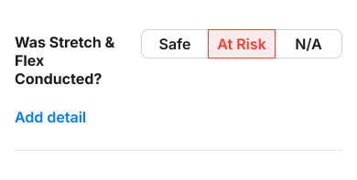
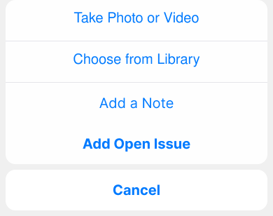
APPROVAL + OPEN ISSUE / SMARTTAGIT, FACTORLAB
From an observation
to action
A flagged answer can lead to a specific next action inside the existing observation flow.
I kept the entry contextual and separated issue creation from approval requests.
September 8 design captures. Engineering reported core Workflow live September 23, 2026.
08
Notes:
September 8 design captures show a contextual Add detail entry and an action sheet within the existing observation flow. Kyle designed issue and approval paths with shared foundations and different requirements. Engineering reported core Workflow live September 23, 2026, with prior Open Issue data migrated. Exact captured screen variants have not been matched against production.

Slide 9
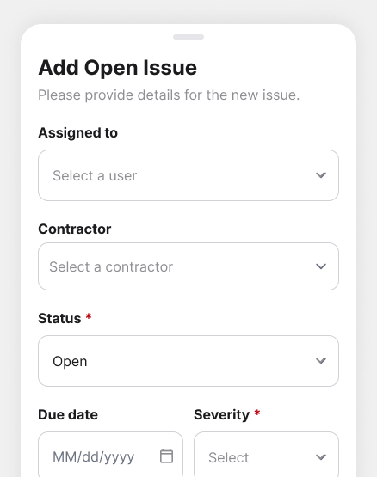
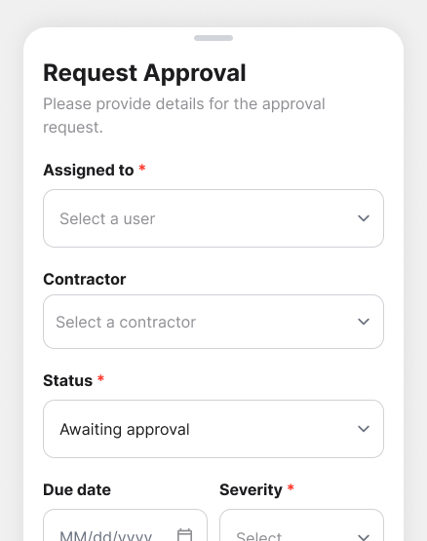
APPROVAL + OPEN ISSUE / TASK-SPECIFIC FORMS
Shared fields, different decisions
OPEN ISSUE
REQUEST APPROVAL
Open status
No required assignee marker
Awaiting approval
Required assignee marker
September 8 design captures · core Workflow reported live September 23 · report/email integrations in review
09
Notes:
September 8 original design captures show empty demonstration forms with no user identities. Kyle reused assignment and detail patterns while defining task-specific required fields and statuses for issue creation and approval requests. Engineering reported the core Workflow live September 23, 2026. Report and email integrations remained under review. These are design-stage captures; exact production visual match and user impact are unverified.

Slide 10
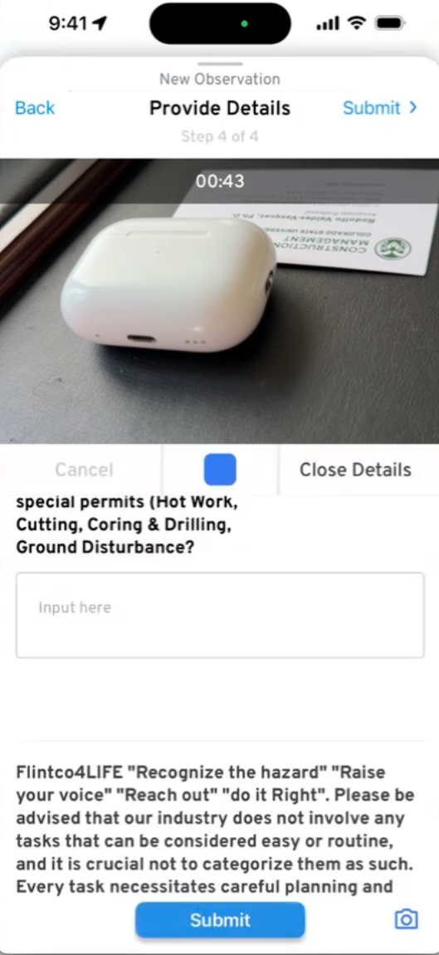
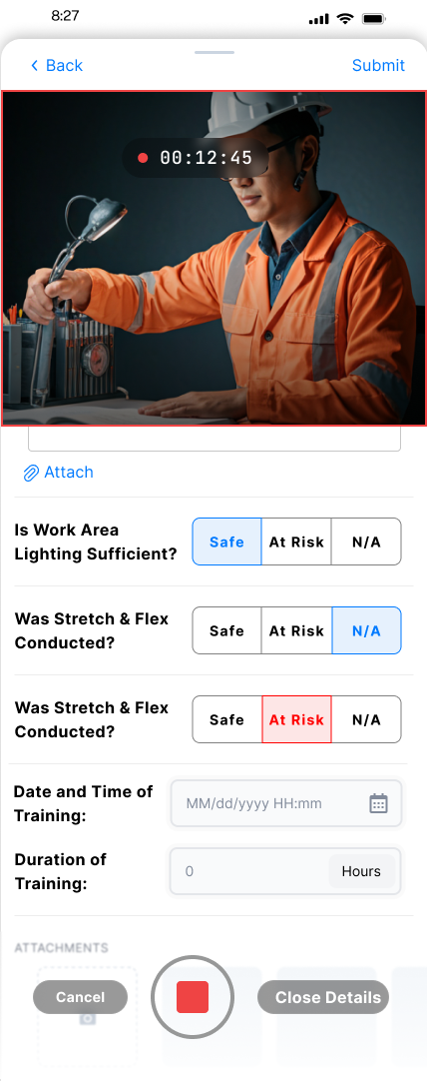
CAMERA CAPTURE / BEFORE AND SCOPED REDESIGN
Untangle the controls
from the form
BEFORE
MY SCOPED DESIGN
Submit appeared twice. Camera controls cut across the form.
With product, I kept the split screen and focused the immediate change on the footer controls.
Consistency and standards: familiar recording controls help people recognize the next action.
10
Notes:
Original before: screenshot supplied by Kyle, corroborated by the April 2 stakeholder walkthrough. The blue square is the Stop control during active recording, not an idle Record button. After: original April design export. The April 14 immediate scope concerned the View Details footer, retaining split-screen and replacing the problematic bottom Submit with camera controls. Implementation and post-change testing remain unverified. Consistency and standards is the design rationale; color alone does not establish accessibility.

Slide 11
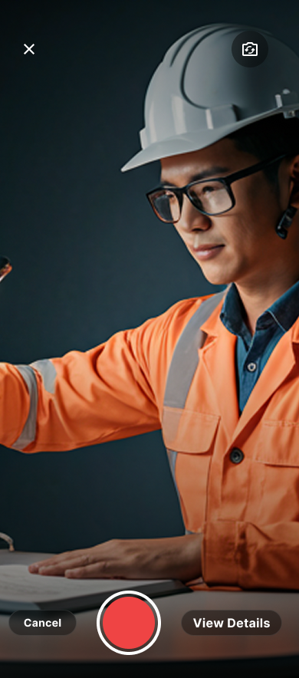
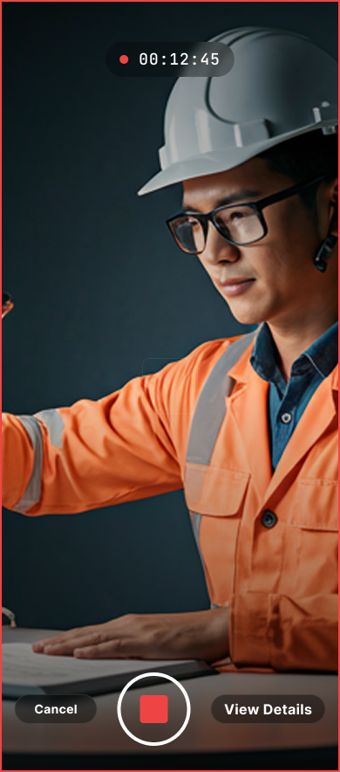
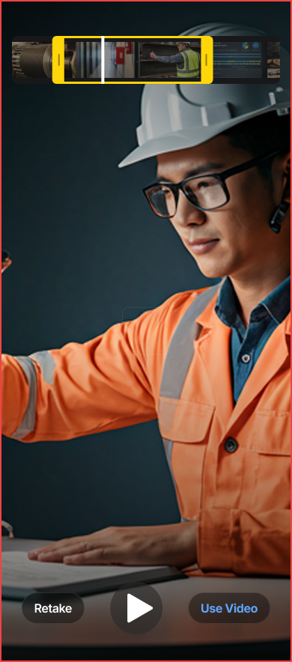
CAMERA CAPTURE / MY BROADER DESIGN EXPLORATION
Make every recording state clear
READY TO RECORD
RECORDING
REVIEW
Cancel, Record and View Details.
Elapsed time and a distinct Stop control.
Retake or choose Use Video.
11
Notes:
Original camera flow designs by Kyle, shown as broader design exploration. These three screens do not imply that the entire polished flow was approved or shipped. In the scope discussion Kyle advocated retaining existing preview, Retake and Use Video functionality. Visibility of system status: elapsed time and Stop distinguish active recording. User control: review allows a decision before keeping the video. No measured task-success or time-saving claim is made.

Slide 12
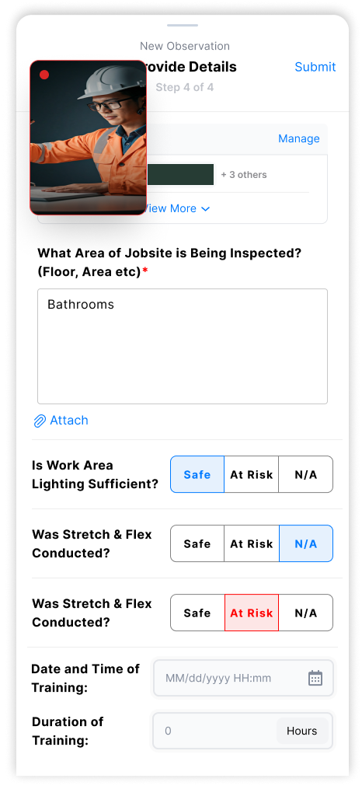
CAMERA CAPTURE / FUTURE PICTURE-IN-PICTURE PROPOSAL
Keep the larger idea
within reach
A movable camera view could leave more room to read and complete the form.
I explained the benefit, worked within the team’s delivery constraints, and handed over PIP separately for future consideration.
Original proposal · benefit not yet tested
12
Notes:
Future-scope PIP proposal supplied by Kyle and supported by original archived designs. A project-name strip is obscured; all other design pixels are preserved. Movability is proposed behavior, not demonstrated by the static image. The April handoff separated PIP from the immediate control change. The intended benefit is more room for form review while recording. It remains a design hypothesis with no verified implementation or user-test result.

Slide 13
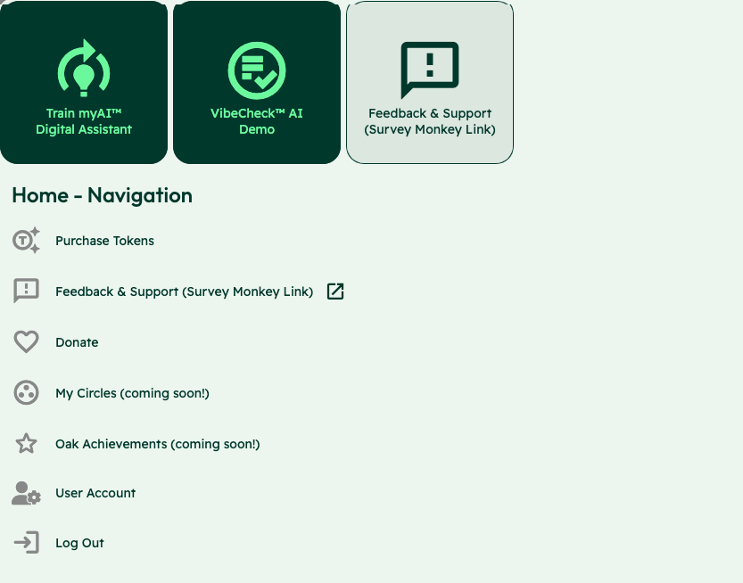
OAK AI / LEAD UX RESEARCHER, 2023–2025
Competing
entry points
Training an assistant, starting a Vibecheck and requesting support competed at the same entry point.
I used the audit to make these choices explicit for the team’s review.
Usability evaluation and design recommendations
13
Notes:
Case: Oak AI. Kyle: Lead UX Researcher, 2023–2025. Source: original Oak navigation evaluation screenshot, with the identity area omitted. Training the assistant, starting Vibecheck and requesting support appear as competing entry points. Kyle documented the labels and visual treatments and used the audit to make these choices explicit for review. Work stage: usability evaluation and design recommendations. This slide does not present a finished navigation redesign or a user-study finding.

Slide 14
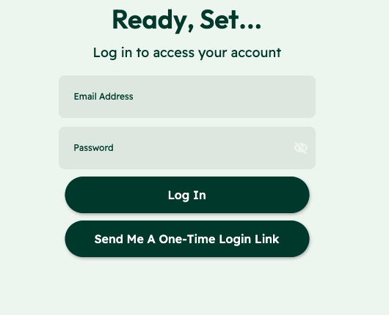
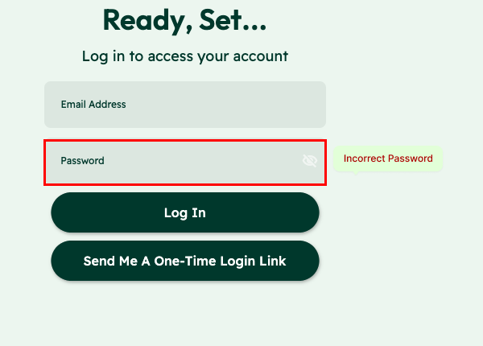
OAK AI / ERROR RECOVERY RECOMMENDATION
Error feedback beside the field
ORIGINAL
MY RECOMMENDATION
The error sat away from the login fields.
Place the correction beside the field.
Separate page-footer message:
Original recommendation artifact.
Exact shipped variant and usability impact unverified.
14
Notes:
Sources: original Oak desktop evaluation and error-messaging recommendation artifact. The shown crops retain original interface pixels and exclude the identity-bearing example field. Original and Proposed labels distinguish the existing interface from the recommendation. The evaluation identified error feedback that did not explain recovery, and the recommendation made a specific correction visible near the password field. This is a recommendation, not a measured usability improvement or a claim that the exact variant shipped.

Slide 15

THE THREAD THROUGH MY WORK
I started by listening
to people’s stories
Documentary filmmaking taught me to listen closely and find the thread in a complicated story.
Those habits stayed with me in research and design. Outside work, I run tabletop games, where listening and helping a group find its way matter too.
15
Notes:
Personal story is based on Kyle’s self-described documentary filmmaking, digital storytelling and game facilitation background. It is an editorial connection, not a measured business-outcome claim. The portrait is a user-supplied personal image, used for identity rather than as project evidence.

Slide 16
KYLE HOBSON / UX DESIGN
Let’s make the
next step clearer
For product and UX design roles, contract projects, and collaborations.
JonathanKyleHobson@gmail.com
jonathankhobson.github.io/portfolio/design
16
Notes:
For product and UX design roles, contract projects and professional collaborations. The displayed contact links are clickable.

